Slide 1

Scrape and analyse customer review data to uncover findings for British Airways
Web scraping to gain company insights
By : KHIRANIA Aya
11/06/2023

Slide 2
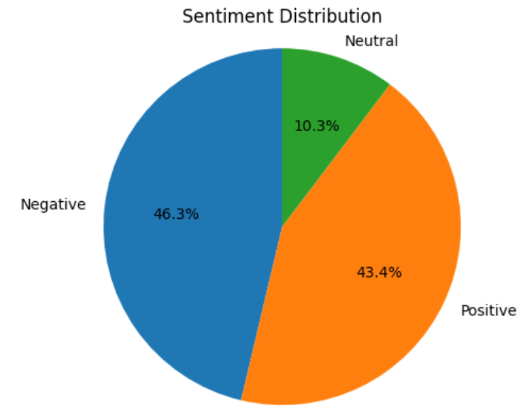
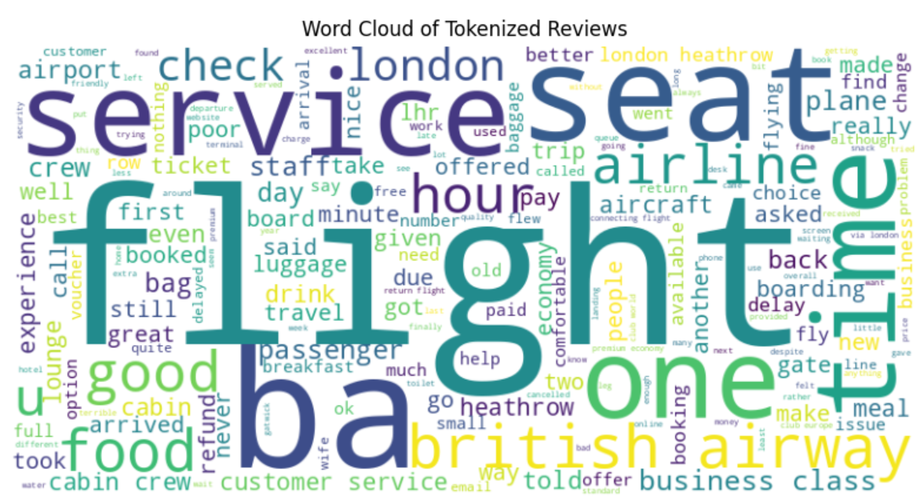
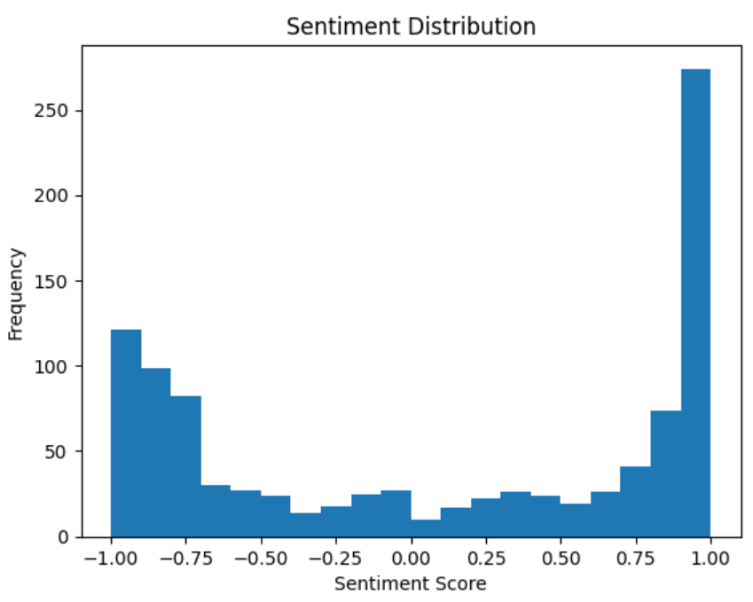
46.3% Negative 43.4% Positive 10.3% Neutral

